Slide 1
Understanding Flexbox in React Native

Slide 2
Layout with Flexbox
A component can specify the layout of its children using the Flexbox algorithm. Flexbox is designed to provide a consistent layout on different screen sizes.
You will normally use a combination of flexDirection, alignItems, and justifyContent to achieve the right layout.

Slide 3
Flex
flex will define how your items are going to "fill" over the available space along your main axis. Space will be divided according to each element's flex property.
In the following example, the red, yellow, and green views are all children in the container view that has flex: 1 set. The red view uses flex: 1 , the yellow view uses flex: 2, and the green view uses flex: 3 . 1+2+3 = 6, which means that the red view will get 1/6 of the space, the yellow 2/6 of the space, and the green 3/6 of the space.

Slide 4
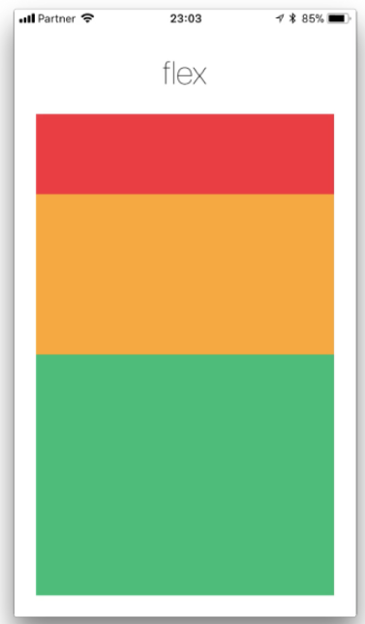

Slide 5
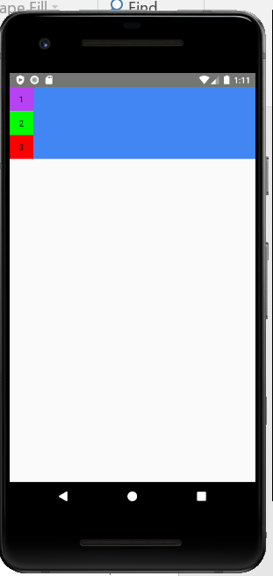
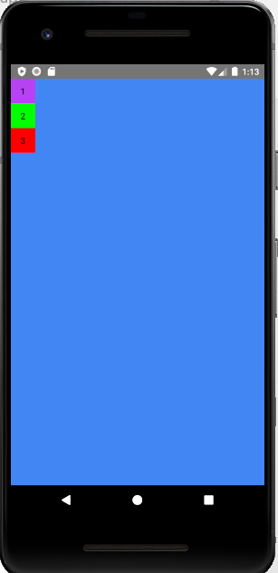
Example1:
flex:1

Slide 6
Flex Direction
row Align children from left to right. If wrapping is enabled, then the next line will start under the first item on the left of the container.
column (default value) Align children from top to bottom. If wrapping is enabled, then the next line will start to the right of the first item on the top of the container.
row-reverse Align children from right to left. If wrapping is enabled, then the next line will start under the first item on the right of the container.
column-reverse Align children from bottom to top. If wrapping is enabled, then the next line will start to the right of the first item on the bottom of the container.

Slide 7
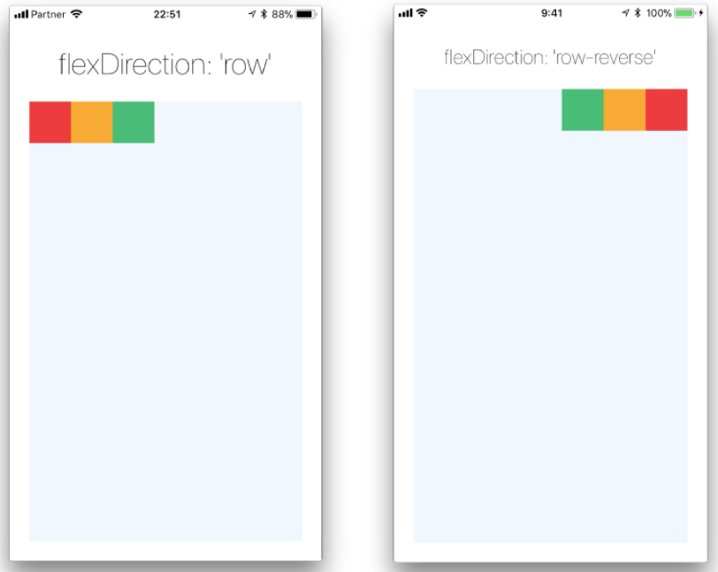
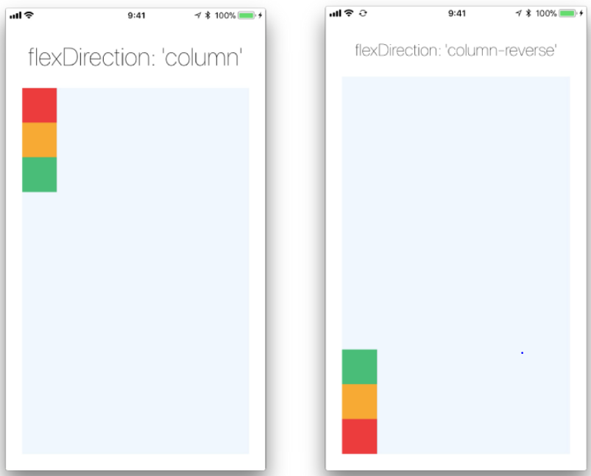

Slide 8
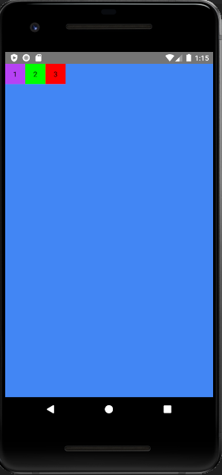
flexDirection:'row'

Slide 9
Justify Content
justifyContent describes how to align children within the main axis of their container. For example, you can use this property to center a child horizontally within a container with flexDirection set to row or vertically within a container with flexDirection set to column.
flex-start(default value) Align children of a container to the start of the container's main axis.
flex-end Align children of a container to the end of the container's main axis.
center Align children of a container in the center of the container's main axis.
space-between Evenly space off children across the container's main axis, distributing the remaining space between the children.
space-around Evenly space off children across the container's main axis, distributing the remaining space around the children. Compared to space-between, using space-around will result in space being distributed to the beginning of the first child and end of the last child.
space-evenly Evenly distribute children within the alignment container along the main axis. The spacing between each pair of adjacent items, the main-start edge and the first item, and the main-end edge and the last item, are all exactly the same.

Slide 10
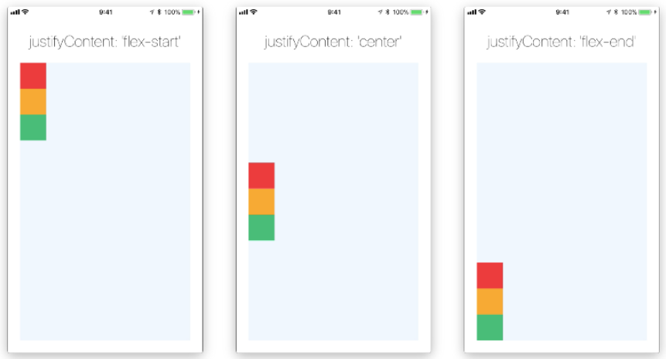
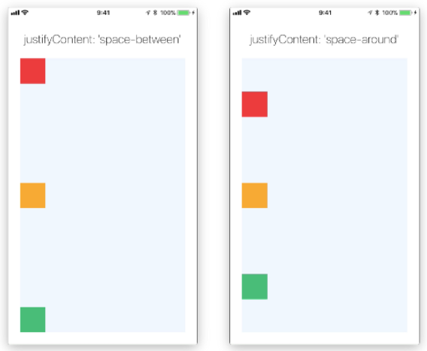

Slide 11
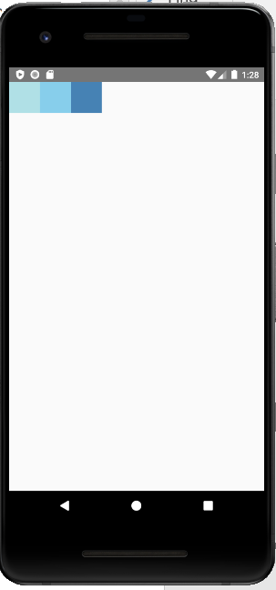
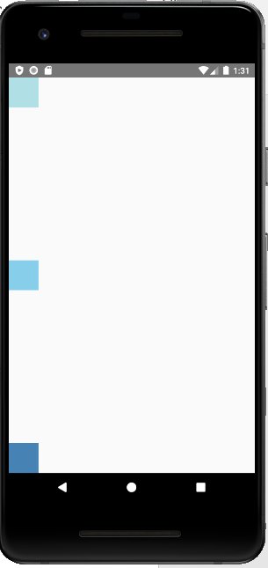
Example2:
flexDirection: 'column',
justifyContent: 'space-between',

Slide 12
Align Items
alignItems describes how to align children along the cross axis of their container. Align items is very similar to justifyContent but instead of applying to the main axis, alignItems applies to the cross axis.
stretch (default value) Stretch children of a container to match the height of the container's cross axis.
flex-start Align children of a container to the start of the container's cross axis.
flex-end Align children of a container to the end of the container's cross axis.
center Align children of a container in the center of the container's cross axis.
baseline Align children of a container along a common baseline. Individual children can be set to be the reference baseline for their parents.

Slide 13
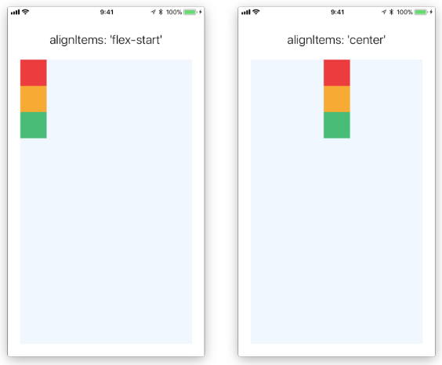
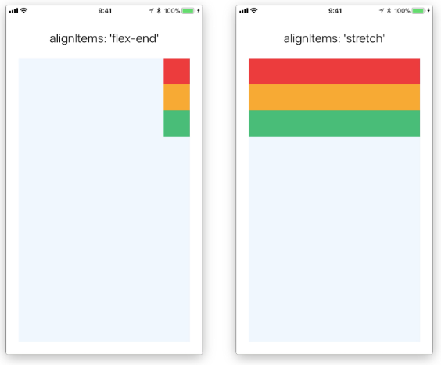

Slide 14
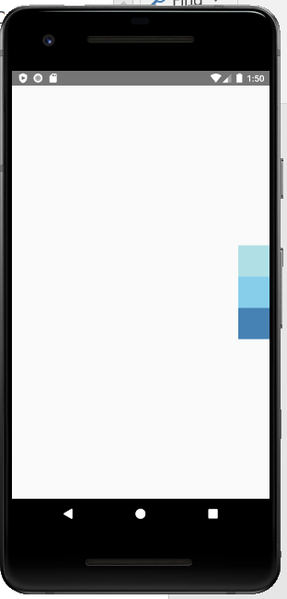
justifyContent: 'center',
alignItems: 'flex-end',

